Slide 1

Project Presentation World war data analysis
Presented by:
k. Sameer kousik

Slide 2

DATA ANALYSIS OF
THE WORLD WARS

Slide 3
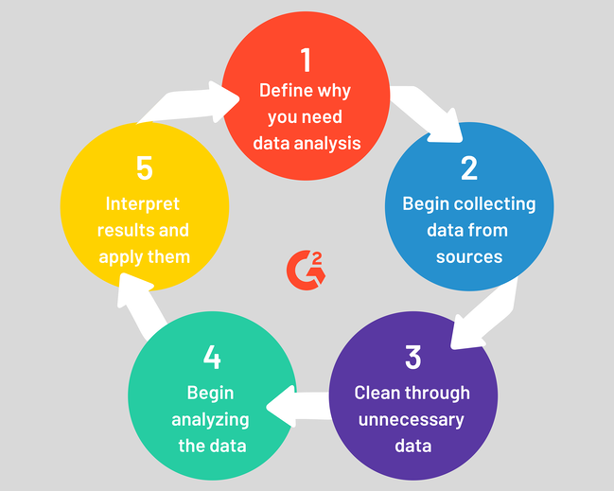

Overview of
Data Analysis Process:

Slide 4
ABSTRACT:
The art of war is of vital importance to the Country. It is a matter of life and death, a road either to safety or to ruin. Hence it is a subject of inquiry which can on no account be neglected. The two World Wars had a significant impact on the World. The race for the arms has been a constant motivation for the advancement in technology by pursuing science.
Our task at hand is to assess the Data from the two major wars in the history of mankind. We approach it by minimalizing the data and categorizing it. We then visualize the data on the world map and in the form of bar charts, bubble charts and comparison of the Wars in the categories of Death Count, Ammunition used, Soldier count, Country count.

Slide 5
INTRODUCTION:
With the help of this project we plan to visualize the effect of world war on countries, regions and even continents. The project also helps to visualize the effect and indirect involvement of countries like India, Australia, New Zealand, though they were way apart from the battle field. The reason could be different for each country in this case, like for India it was because of British Empire ruling India during both wars.

Slide 6
MODULES USED
PANDAS
CSV
NUMPY
CUFFLINKS
PLOTLY
iPYLEAFLET
MATPLOTLIB
JUPYTER NOTEBOOK ( RECOMMENDED )

Slide 7
System Requirements:
Python3 must be installed.
Any Linux Distribution( Debian/ Ubuntu/ RedHats) / Microsoft Windows 10/8/7/Vista/2003/XP must be installed
All the required Modules must be installed using PIP.
4 GB RAM recommended.

Slide 8
DATASET Preparation
· World War 1: This data set was manually copied from Wikipedia and then edited in Google Fusion Table. Firstly, the unwanted national flags were removed manually using an excel sheet. Then the data was imported to google fusion table and following processes/operations were carried out in fusion table: a. Geo Coding all the countries. b. Adding the Geo Code columns. c. Removing blank entries. d. Formatting the numbers to remove the unwanted commas from the deaths count. e. Removing unnecessary columns not required for analysis. f. Downloaded to local machine.

Slide 9
DATASET PREPERATION
· World War 2: An itemized list of data entries was referred from the fusion table from fallen.io. Following processes/operations were carried out in fusion table: a. Did summarization per country and deaths count. b. Doing a sum of deaths count per country. In this table we had multiple entries for single country. E.g. Entry for United States was present 67 times. The sum function helped to create only 1 row entry per country. c. Geo Coding all the countries. d. Adding the Geo Code column. e. Fixing the death count number format. f. Removing blank entries and data. g. Removing unnecessary columns not required for analysis. h. Downloaded to local machine.
· Compare World War I and II: Manually created this csv which contains only the total death count of both wars.

Slide 10
Data Visualization:
The Data is Analysed by plotting required Graphs and Maps.
Various Graphs : Bar , Scatter, Bubble and Histogram are plotted.
The graphs are shown in the following slides.

Slide 11
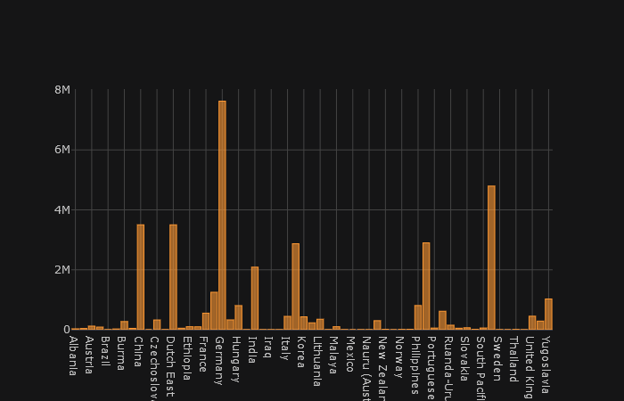
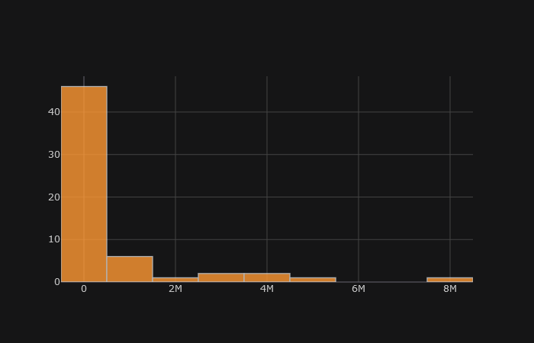
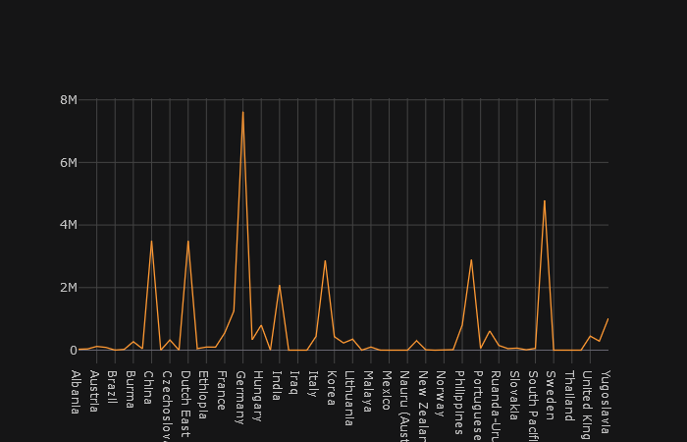
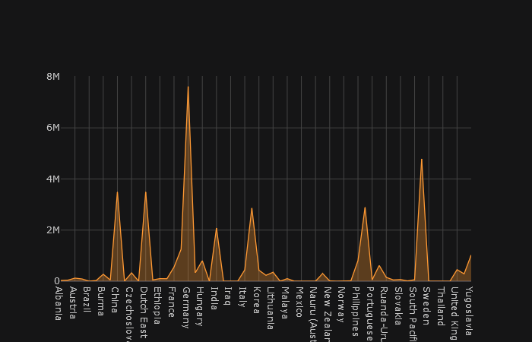
Death Distribution in World War I

Slide 12
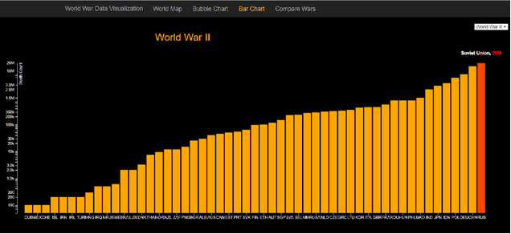
WORLD WAR DEATHS

Slide 13
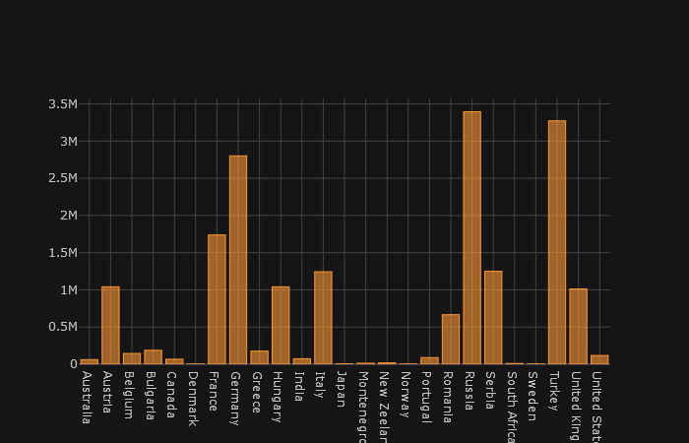
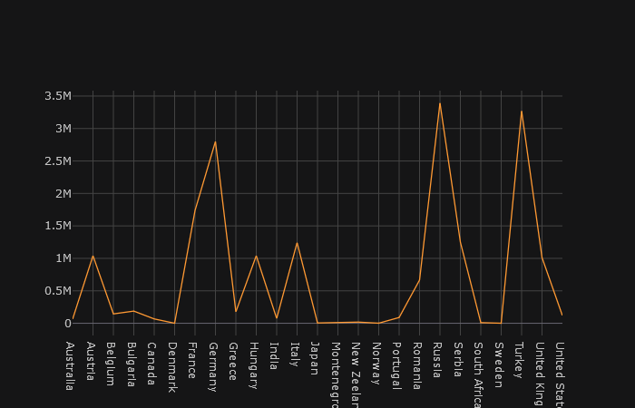
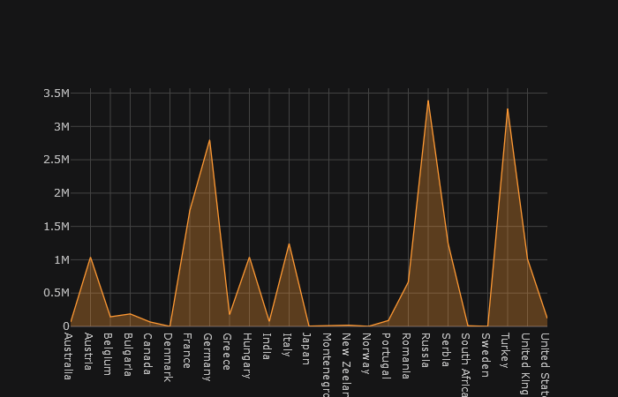
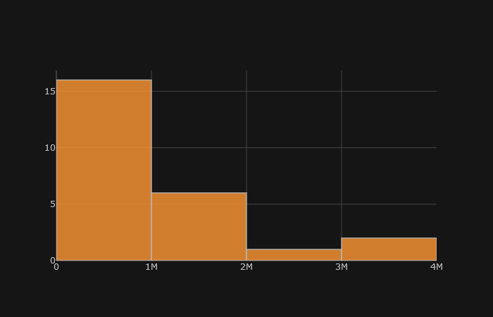
DEATH DISTRIBUTION IN WorlD WAR 2

Slide 14
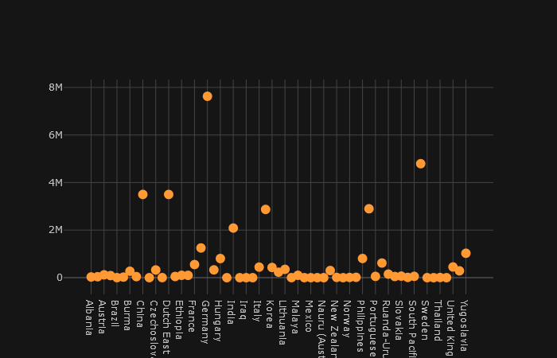
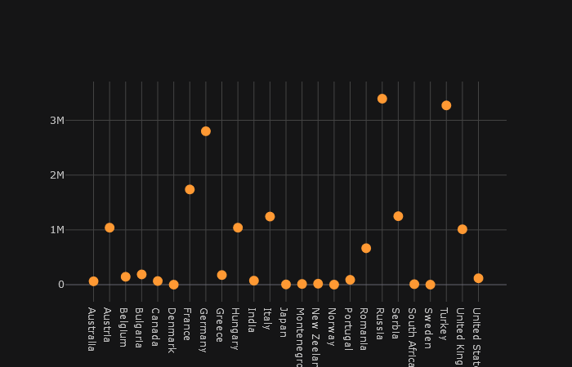
BUBBLE CHARTS
WORLD WAR II
WORLD WAR I

Slide 15
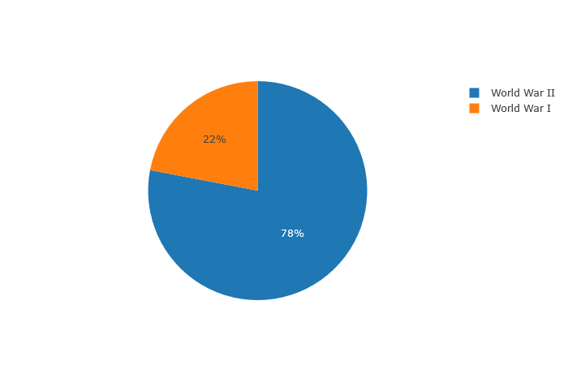
COMPARISION OF THE WORLD WARS

Slide 16
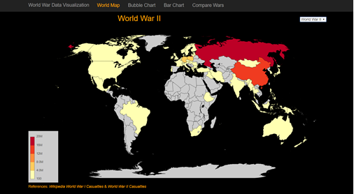
Countries in world wars

Slide 17
Conclusion
With the help of this project we visualized the effect of world war on countries, regions and even continent. It is quite clear from the world map that how Europe was the most effected in both world wars and how continent like Africa, North America, Middle East were not. The project also helps to visualize the effect and involvement of some countries like India, Australia, New Zeeland, though they were way apart from the battle field. The reason could be different for each country in this case, like for India it was because of British Empire ruling India during both wars and many soldiers travelled away from India for the war.

Slide 18
Conclusion
More than 18.5 Million people (military + civilians) were killed in world war I and more than 65.3 Million people (military + civilians) were killed in world war II. Total around 83 Million people were killed which is much more than summing all the wars deaths which happened on earth.

Slide 19
References:
https://en.wikipedia.org/wiki/World_War_I
https://en.wikipedia.org/wiki/World_War_II_casualties
https://data.world/search?q=world+war

Slide 20
The Code and Repository for the Project are available on my GITLAB/ GITHUB Account.
Project Links:
GITLAB LINK:
https://code.swecha.org/sameerkousik/world-war-data-analysis
GITHUB LINK:
https://github.com/sameerkousik/World-War-Data-Analysis

Slide 21

Thank You

